Slide 1
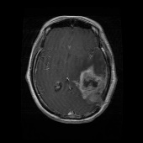
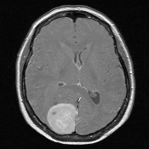
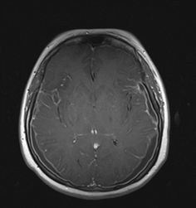

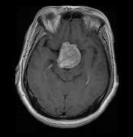
Normalization
Glioma
Meningioma
Convolution 2-D
Batch Normalization
Max_Pooling 2-D
Flatten
FC
Dropout
Resize (64*64)
FC (4 class)
4 X
2 X
No tumor
Pituitary
Pre-processing
Feature extraction
Classification

